Slide 1



Hospitality Project
View in Power BI
Last data refresh:
3/5/2025 4:56:06 AM UTC
Downloaded at:
3/6/2025 6:27:55 AM UTC

Slide 2
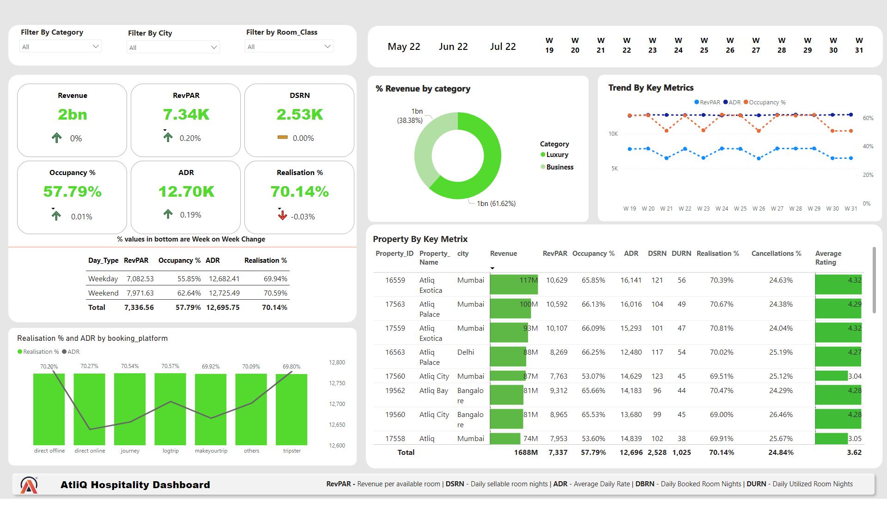
Home
Notes:
slicer
No alt text provided
slicer
No alt text provided
slicer
No alt text provided
slicer
No alt text provided
slicer
No alt text provided
Property By Key Metrix
No alt text provided
lineStackedColumnComboChart
No alt text provided
shape
No alt text provided
shape
No alt text provided
shape
No alt text provided
shape
No alt text provided
shape
No alt text provided
shape
No alt text provided
shape
No alt text provided
cardVisual
No alt text provided
tableEx
No alt text provided
% Revenue by category
No alt text provided
Trend By Key Metrics
No alt text provided
shape
No alt text provided
textbox
No alt text provided
shape
No alt text provided
textbox
No alt text provided
image
No alt text provided
tableEx
No alt text provided
tableEx
No alt text provided
tableEx
No alt text provided
tableEx
No alt text provided
tableEx
No alt text provided
tableEx
No alt text provided
textbox
No alt text provided

